Slide 1
& Blind Health
Accessible Pharmacy Services Blind Health Expo 2024

Slide 2
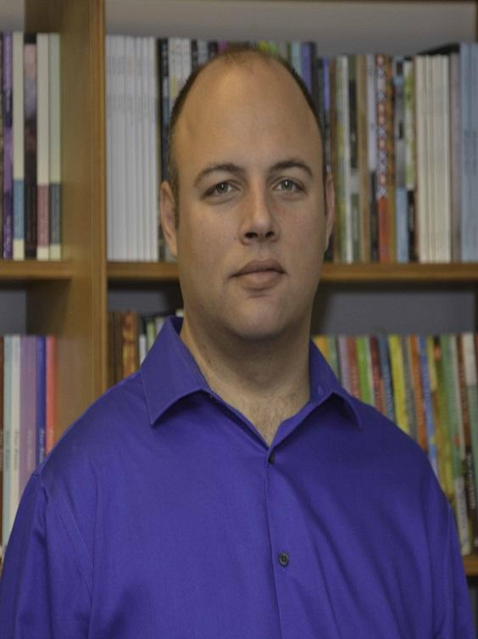
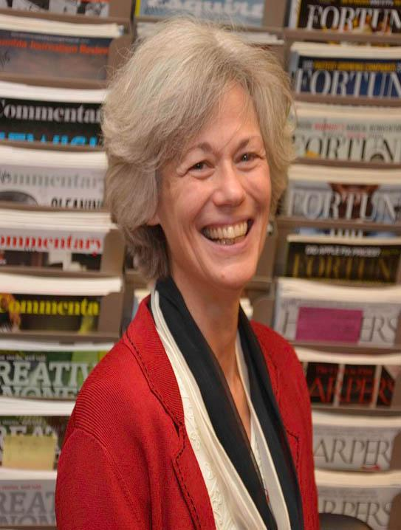
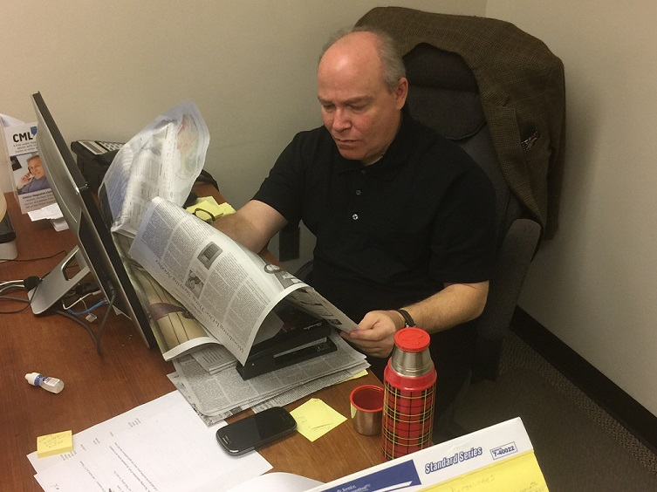
Presenter Introductions:
Michael Tedeschi
Publisher
Port Washington, NY
Jay Popham
Associate Editor
Austin, TX
Annie Kyrkostas, MLIS
Editor-in-Chief
Long Island, NY
Alfredo Franco
Associate Editor
New Jersey
Raquel Sime
Office Manager
Long Island, NY

Slide 3
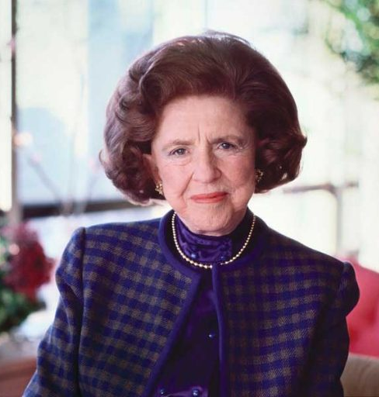
About Us:
Founded in 1962 by philanthropist LuEsther T. Mertz
Based in Port Washington, NY
5 staff
CML's mission: “charitable, literary, and educational,” to empower people with print disabilities by giving them access to the same information and literature that sighted individuals enjoy
Provided free in a range of formats
LuEsther T. Mertz

Slide 4
CML Vision Statement
Choice Magazine Listening seeks to address the problem of limited access to information and literature for people with blindness or print disability.
We aim to solve this problem by providing a free audio magazine that allows our listeners to stay connected to current events, literature, and the arts.
We seek to emphasize writings that are insightful, humane, thought-provoking, enlightening, possibility-driven, candid, persuasive, and vital—we want to capture the full range of what people can be, do, and imagine with words.

Slide 5
About our publication, Choice Magazine Listening:
A free talking book anthology of the best in literary and magazine writing.
12 hours of listening, released quarterly
Drawn from a list of nearly 100 outstanding periodicals
Professionally recorded by Talking Book Publishers in Denver, Colorado
Includes all forms of writing—
Fiction [Hernan Diaz, Louise Erdrich, Wendell Berry]
Nonfiction [Dan Barry, Fintan O’Toole, David Wallace-Wells]
Poetry [Jorie Graham, Sharon Olds, Yusef Komunyakaa]
Interviews [Mel Brooks, Ray Kurzweil, Maya Angelou, John le Carré]
Essays [Richard Russo, Barry Lopez, Jon Mooallem, Ishion Hutchinson]
We want to provide something for everyone
Notes:
Professionally narrated by voices such as Gabriella Cavallaro, Mare Trevathan, Bill Wallace, Doug Tisdale Jr., and Guy Williams, among others!

Slide 6
Our Subscribers:
CML is a publication for a general audience of adult readers with blindness, low vision, or any other print disability, as defined by the National Library Service for the Blind and Print Disabled (NLS):
Any resident of the United States or American citizen living abroad who is unable to read or use regular print materials as a result of temporary or permanent visual or physical limitations may receive service through NLS. This includes those who are blind or have a visual, physical, perceptual, or reading disability that prevents them from reading or handling print materials.
We seek listeners with a passion for literature, the arts, and the life of the mind.
Listeners’ eligibility is attested to by a certifying authority and validated by the NLS network.
Listeners’ equipment is provided and maintained by the state or regional Talking Book Library in their area. All you need is membership in the NLS BARD program.
Our subscribers hail from every US state and territory. We’d like to be read worldwide!
Notes:
Live demo of NLS BARD on web and iOS

Slide 7
(Just some of) our sources:
The New York Times
The New Yorker
Harper’s
The Atlantic
Smithsonian
The Paris Review
Brick
Granta
Zoetrope
The Sun
Audubon
AGNI
The Believer
Commentary
Condé Nast Traveler
Creative Nonfiction
Esquire
Five Points
Foreign Affairs
The Hudson Review
The Kenyon Review
McSweeney’s
n+1
National Geographic
Nautilus
Outside
Oxford American
Sports Illustrated
Texas Monthly
WIRED

Slide 8
Our formats:
There are several ways to get your quarterly CML subscription.
Digital Download
Available immediately
Either through our website, choicemagazinelistening.org [format NISO 39.86-2002] or the NLS BARD program
Requires a USB thumb drive to operate with NLS Digital Talking Book player
Nothing to return, easy to store
Digital Talking Book Cartridge
Shipped by USPS’s Free Matter for the Blind
Returned by subscribers and recycled for future issues
Cassette Tape (legacy format)
Notes:
In September of 1962, the first issue of Choice Magazine Listening was published. At that time, the standard format used by the talking book libraries was 16 2/3 RPM records. These records were recorded at a special speed that only specific players, which were given to visually impaired patrons at no cost to them, from the Library of Congress, were able to play.
Over the years, the formats have changed dramatically. After records were eventually phased out, cassette tapes were used, again recorded on special media, for specialized players, provided to patrons in the same manner as the record players.
Advance to today, we are now produced on digital media, ensuring that there will always be a copy of Choice Magazine Listening available at any time, to anyone with capabilities of listening. From September 1962 through December 1989, records, of various sizes throughout those years, were produced.
From January 1990 through September 2007, Choice Magazine Listening was produced on 4-Track cassette tapes. Starting with November 2007, Issue 274, Choice Magazine Listening was produced on digital cartridges.

Slide 9
CML “Extras”
The CML Archives:
With every new issue, we release a year’s worth of archival back issues
Winter 2025: back issues from 1974, including Watergate, Stevie Wonder, short stories by Arthur C. Clarke, poetry from Pablo Neruda, and much, much more
The CML Newsletter:
We alert subscribers and friends of CML as soon as a new issue is available for download
Released four times a year—we will never re-sell or share your information with third parties
The absolute fastest way to get CML
CML & You:
We want to know if you have a book club! Every issue of our publication includes a range of literary fiction, nonfiction, essays and poetry suitable for discussion.

Slide 10
Questions?
Annie Kyrkostas (MLIS), Editor-in-Chief
annie@choicemagazinelistening.org
Mike Tedeschi, Publisher
mike@choicemagazinelistening.org
Raquel Sime, Office Manager raquel@choicemagazinelistening.org
Jay Popham, Associate Editor
jay@choicemagazinelistening.org
Alfredo Franco, Associate Editor
alfredo@choicemagazinelistening.org
Choice Magazine Listening
85 Channel Drive
Port Washington, NY 11050
www.choicemagazinelistening.org
Toll-free: 1-888-724-6423
facebook.com/ChoiceMagazineListening

