Slide 1
A Liquid Measurement Device for the Blind & Low-Vision Community
Chiadika Eleh and Joey Wei
Ⓒ2024 See-Rynge LLC. All Rights Reserved

Slide 2
Problem
Liquid measurement is a significant challenge for the blind/low vision community
This problem prevents blind/low vision individuals from properly caring for themselves and their loved ones
Notes:
CHANGE ICONS

Slide 3
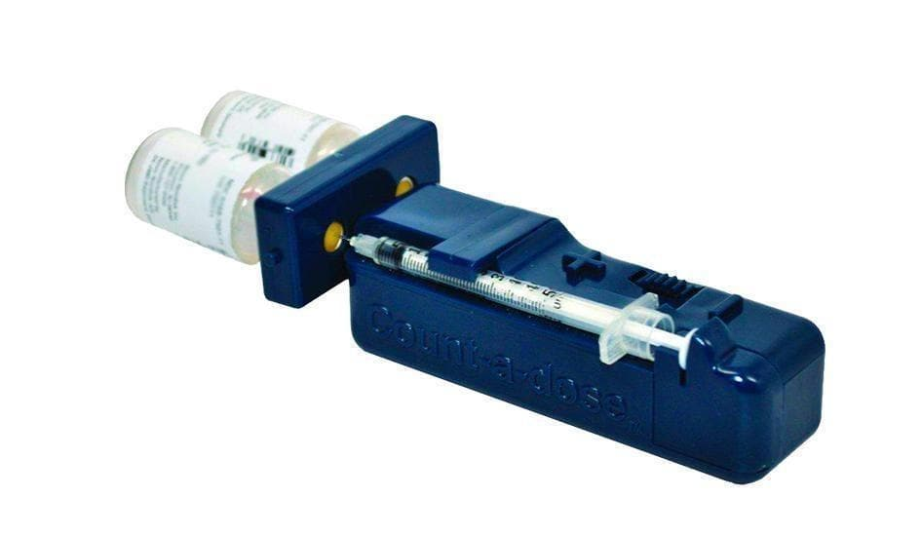
There Are Currently No Viable Alternatives
Count-A-Dose
(for insulin measurement ONLY)
DIY Tactile Syringe
Mechanical Precision
Auditory Feedback
Purchasable
Relevant Volume Range (>1mL)
"With NyQuil, I swig what I think is a shot..."
- a Blind National Federation of the Blind (NFB) member

Slide 4
The Inability to Measure Liquid Medication Hampers Independence and Increases Cost
Visually Impaired 20 million Americans
$16,838 Avg. annual burden per blind/low vision individual
Rehab clinics cost up to $4,000 per day
Vision Loss 6 million Americans
(20/40 to 20/200)
$41.8bn Annual nursing home costs attributed to blind/low vision patients
Blind
1 million Americans (Worse than 20/200)
Data from CDC., Georgetown University

Slide 5
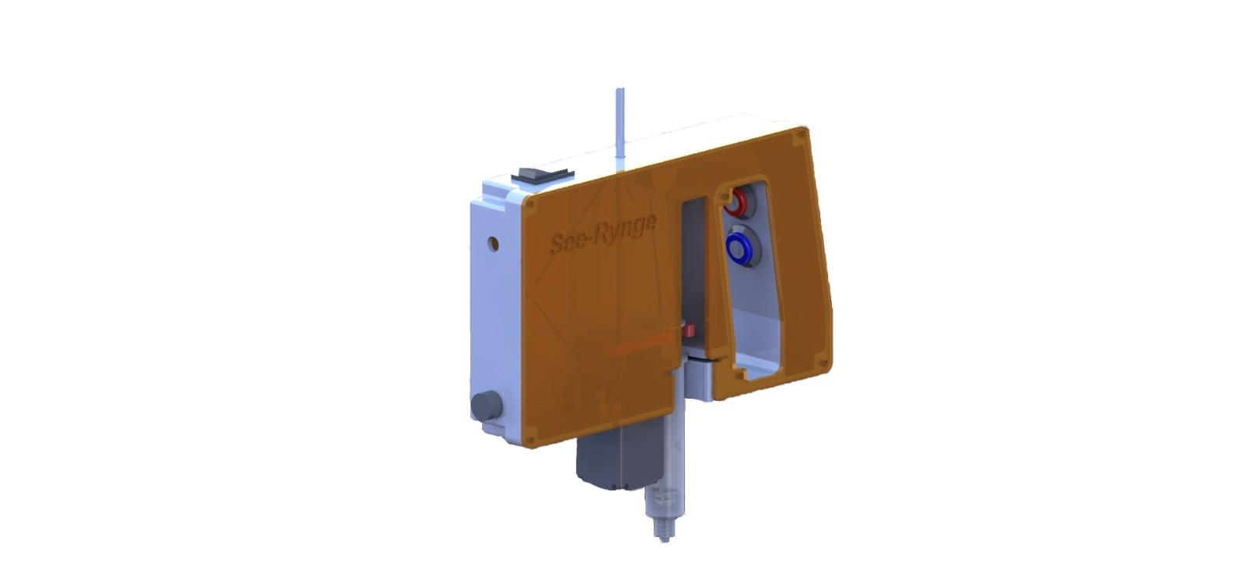
A Liquid Measurement Device for the Blind & Low Vision Community

Slide 6
On/Off Switch
Buttons
Clamps
Stepper Motor
Disposable Syringe

Slide 7
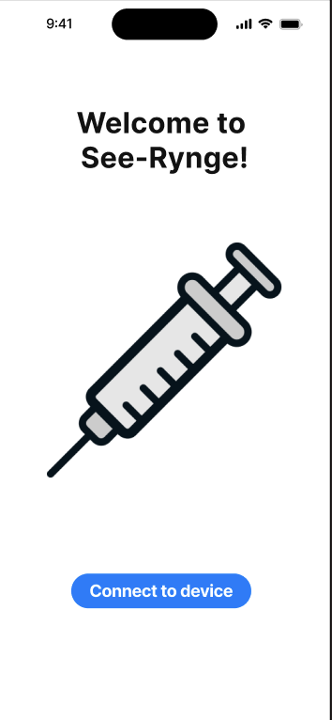
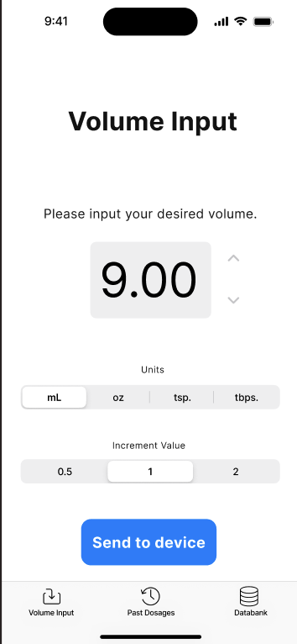
Our Blind-Accessible App Has Full Functionality
Welcome Page
Volume Input Page

Slide 8
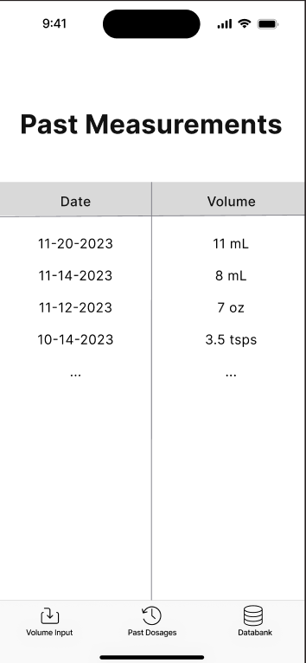
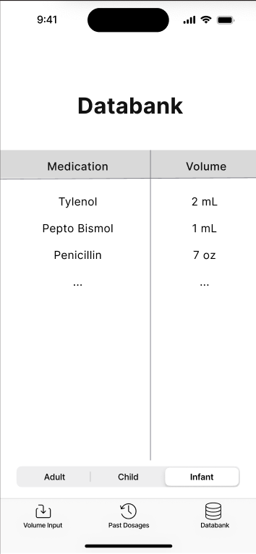
Our Blind-Accessible App Has Full Functionality
Past Measurements Page
Databank Page

Slide 9
See-Rynge Satisfies Several Criteria
Precision: Within ±3% of target volume to meet international regulations
Accessibility: Audio & haptic feedback systems
Form Factor: Handheld and ergonomic
Automation: Integrated operating system for automatic function
Accountability: Innovating with the target population in mind (and in discussion!)
Notes:
How do we want this problem to be solved? We want something that is….

Slide 10
Initial Target Market is Approximately 1 Million Patients
50,000+ NFB members
30,000+ Clients of Current Partner Organizations
9/12
NFB Members Expressed Immediate Interest
75,000+ members of local clinics
1,000,000+ Low Vision Veterans
“ I need this now “
- Paula, Blind Throat Cancer Patient Dissatisfied with Current Options
Estimated Target Market in PA alone: 40,000

Slide 11
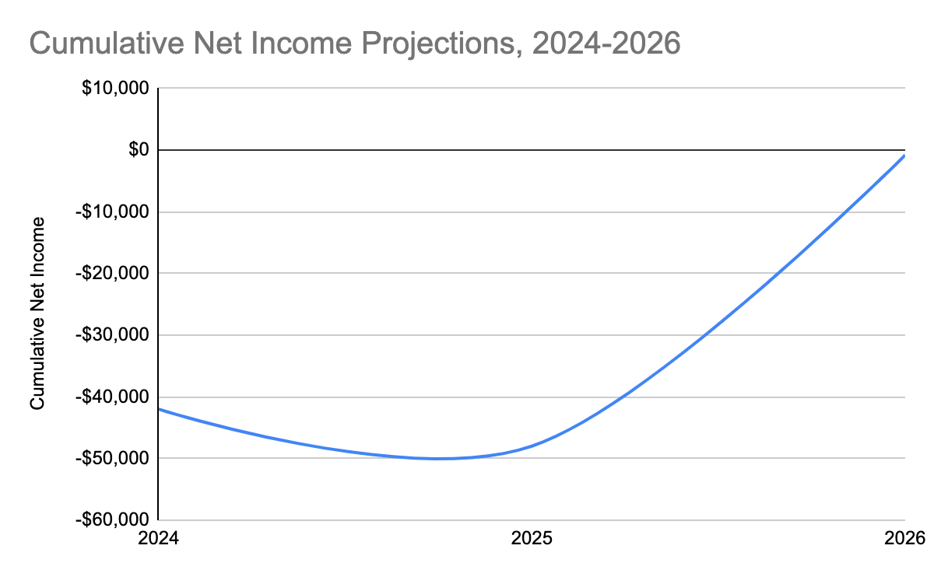
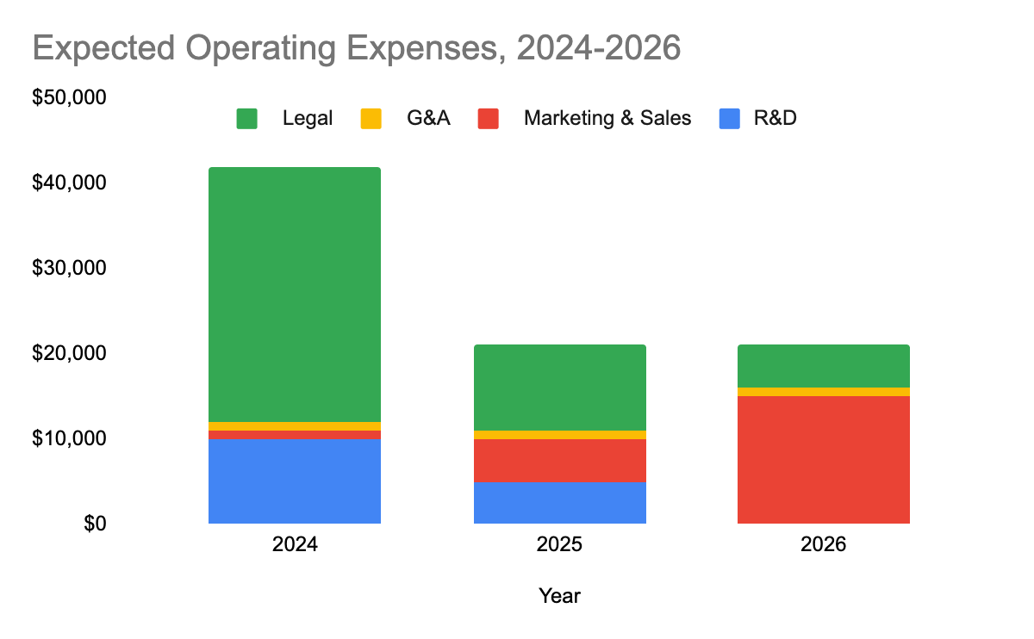
Minimum Initial Price of $50 Will Lead to Break Even After 11,000 Sales
Anticipated Initial Cost per Device: ~$45
State-run incentives, grants, and insurance will lower out-of-pocket costs, opening door for price increase
Patent filing & FDA Trials will lead to high legal costs in 2024 & 2025, eventually replaced by marketing

Slide 12
Medication for the Low-Vision Population is Only the Beginning
Blind Users
Expanding Beyond Blind Population
Small
Measurement Aids
Other Accessibility Devices
Intellectually Disabled
Physically Disabled
Cooking Aids
Medication Tracking
Tabletop Device

Slide 13
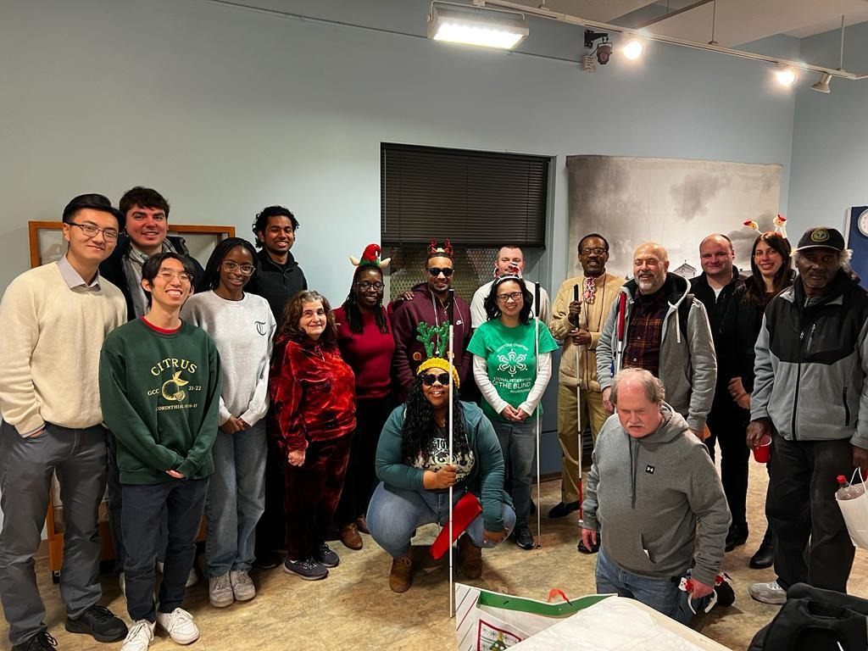
Our Team is Dedicated to Solving this Problem
Chiadika Eleh: Software engineer at Google; BSE and MSE in Bioengineering @ UPenn
Joey Wei: Integration engineer at Epic; BSE in Bioengineering @ UPenn

