Slide 1


Maryland Assistive Technology Program
Maryland Department of Disabilities

Slide 2
ABOUT US
Maryland TAP provides statewide access to assistive technology (AT) through equipment demonstrations, loans, reuse, financing, and training.
www.mdtap.org
We’re a free, statewide service through the Maryland Department of Disabilities.

Slide 3
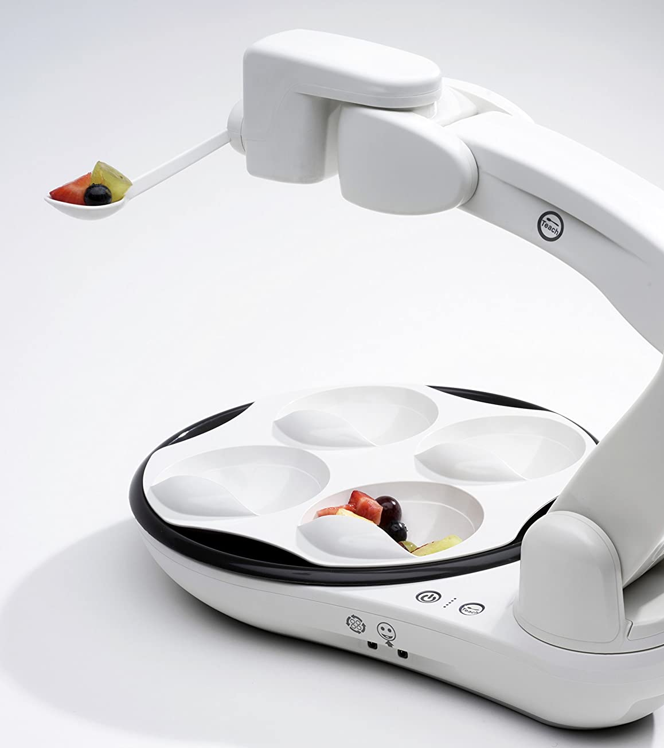
WHAT IS ASSISTIVE TECHNOLOGY?
Assistive Technology, also known as AT, encompasses a wide variety of items from low-tech such as a claw reacher to high-tech devices that utilize smart screens and speakers to “speak” for someone who is nonverbal. And everything in-between!
AT improves a person’s functional abilities so that individual can have greater independence and success with a task(s).

Slide 4
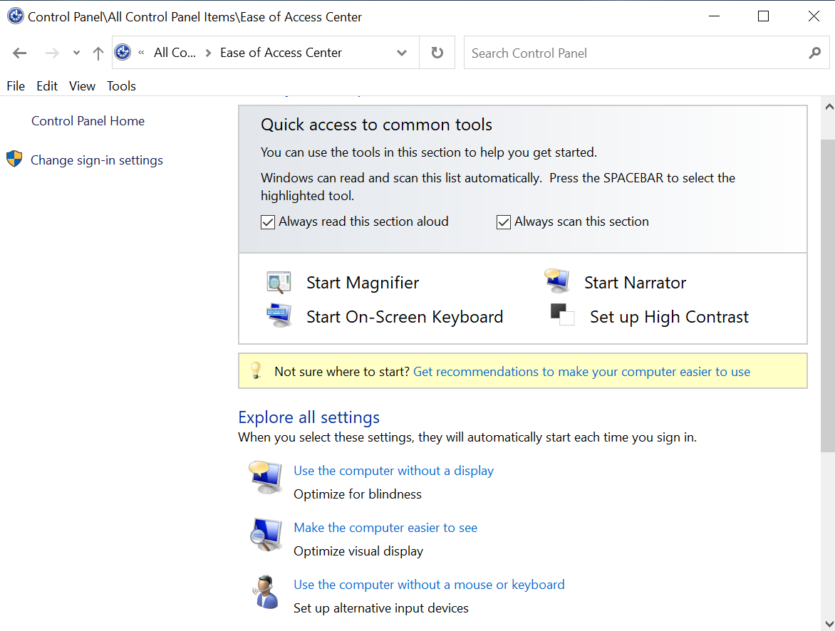
From Mainstream to Dedicated
AT can be technology made to be used by anyone but is utilized by someone with a disability to increase independence OR it can be a device created specifically with a certain disability in mind!
Examples:
  Magnification built into the OS of your laptop
  An OCR app designed for blind users to take pictures and hear content read back BUT used by a student who benefits from audio feedback when processing content
  Smart Thermostat or Alexa Microwave

Slide 5
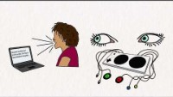
AT: Plain & Simple
https://youtu.be/vdOw6N8Mwyk

Slide 6
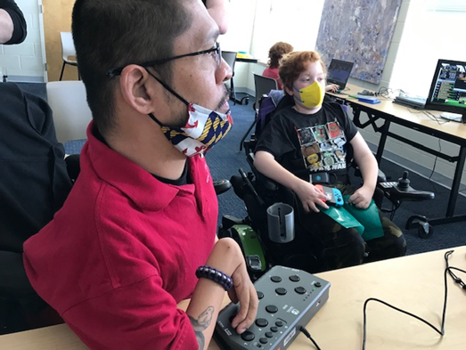
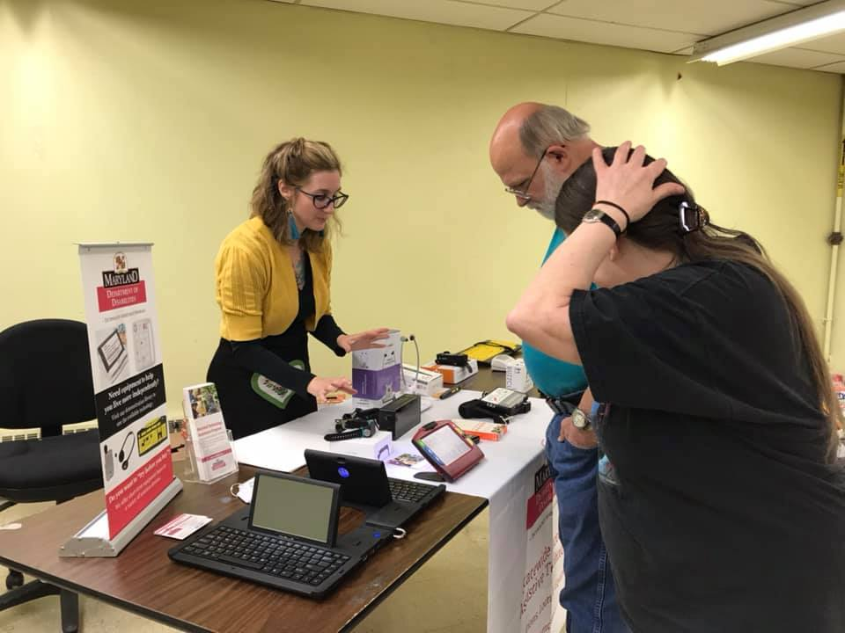
WhAT We Do in Maryland
AT demonstrations and consultations with AT Clinicians – In-person and virtually!
Issue short-term device loans, up to 4 weeks at a time to try before buying
Host in-depth AT sessions exploring a variety of AT topics - In-person and virtually!
Host statewide AT events such as Accessible Gaming Days, Financial Resiliency Webinar Series, and more!
Provide low-interest financial loans and run the High-Tech AT Reuse Center
IT Accessibility Initiative – training, evaluation, and remediation for digital accessibility within state government

Slide 7
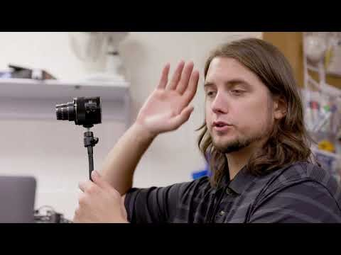
Who We Are
https://youtu.be/ixFm30tkjAc

Slide 8
AT Libraries

Slide 9
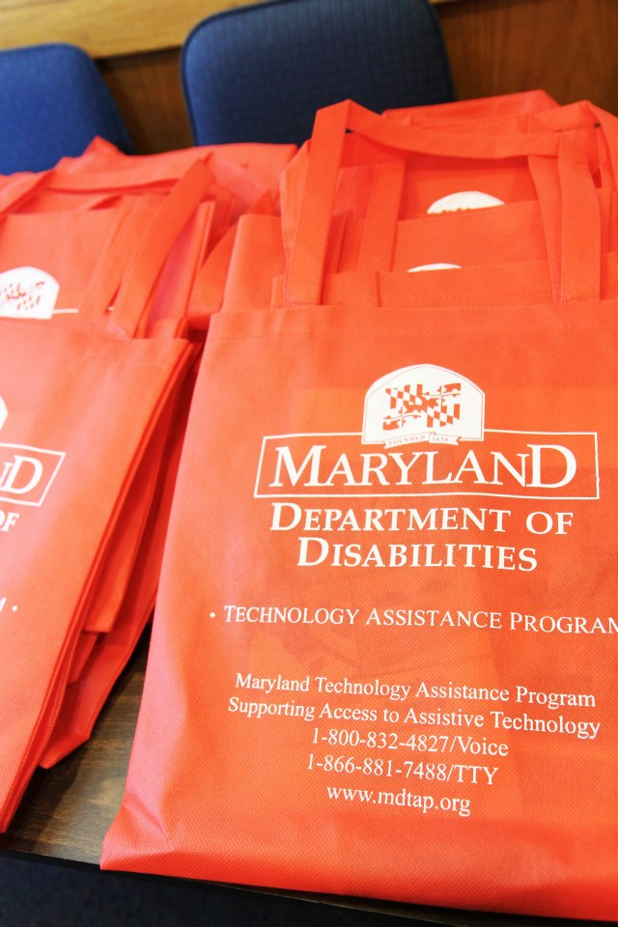
Community AT Libraries across the State
Community AT Libraries – 9 Locations
MDTAP – Statewide
Maryland Assistive Technology Program
Central Maryland
(Baltimore City, Harford, & Baltimore Counties)
IMAGE Center
(Anne Arundel & Howard Counties)
Accessible Resources for Independence
(Howard County Only)
Howard County Loan Closet - AT Library
Northern Maryland
(Harford & Cecil Counties)
Arc Northern Chesapeake Center
By appointment only

Slide 10
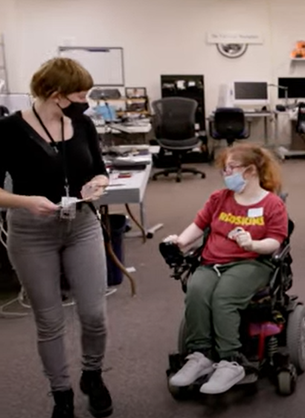
Libraries, cntd.
Southern Maryland
(Calvert, Charles and St. Mary’s Counties)
Southern Maryland Center for Independent Living, Inc. (SMCIL)
(Montgomery & Prince George's Counties)
Independence Now
Western Maryland
(Allegany, Garrett, and Washington Counties)
Resources for Independence, Inc.
(Carroll & Frederick Counties)
Freedom Center of Maryland
Eastern Shore
(Caroline, Cecil, Dorchester, Kent, Queen Anne’s, Somerset, Talbot, Wicomico and Worcester Counties)
TBD

Slide 11
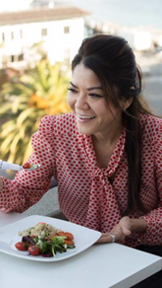
AT for Independent Living!
Liftware Level
Zipper Pull

Slide 12
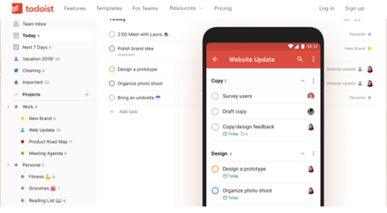
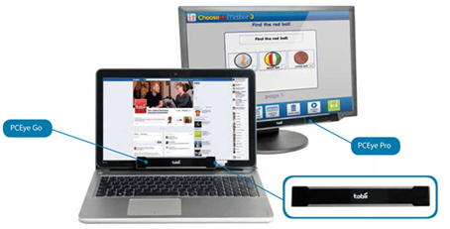
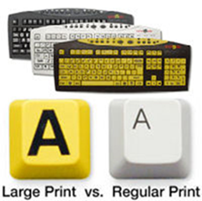
AT for School & Work
Memory & Cognition Aids

Slide 13
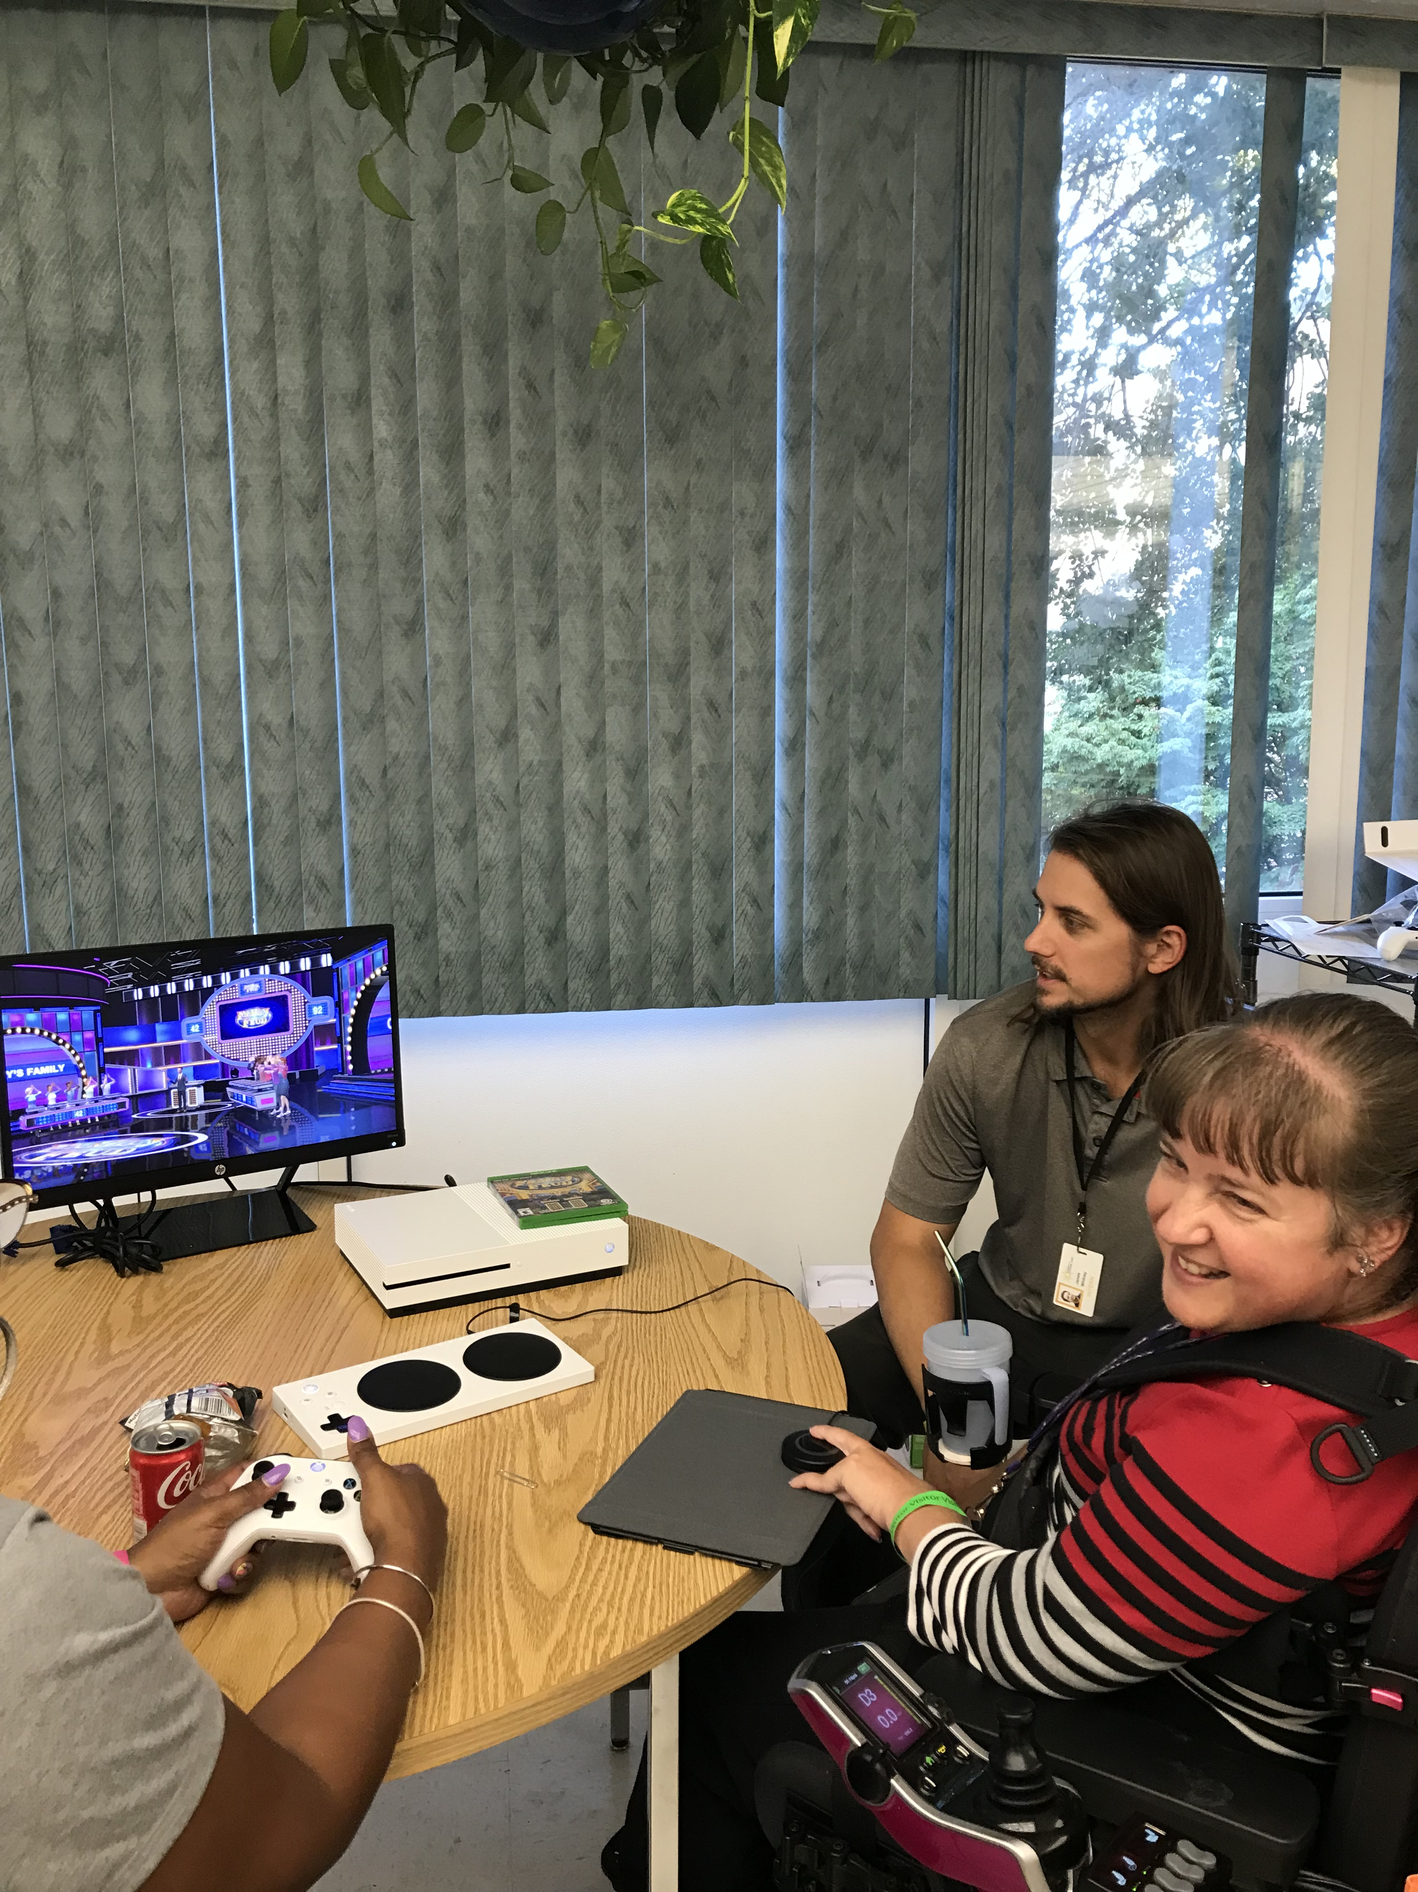
AT for Fun!
Adapted Dice & Gaming
Adapted video game controllers

Slide 14
Recycled / Refurbished AT & DME

Slide 15
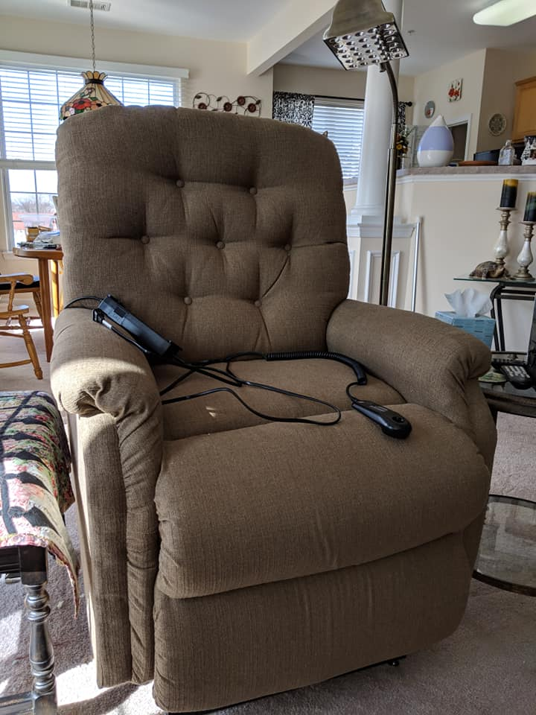
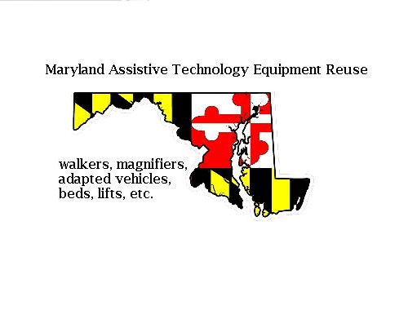
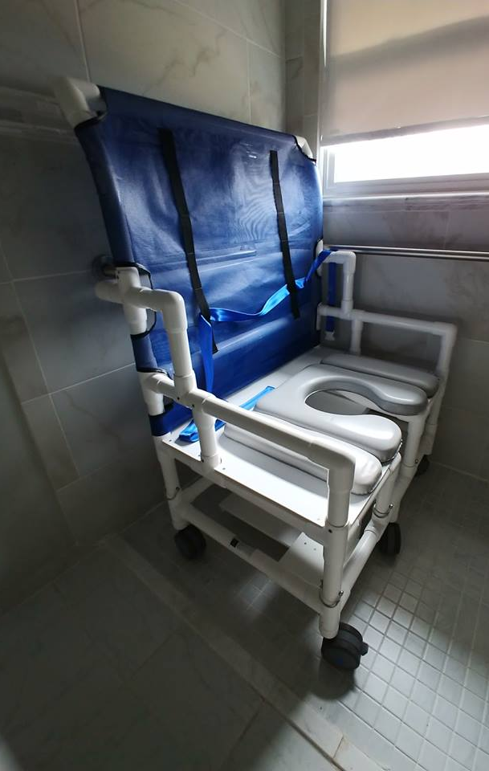
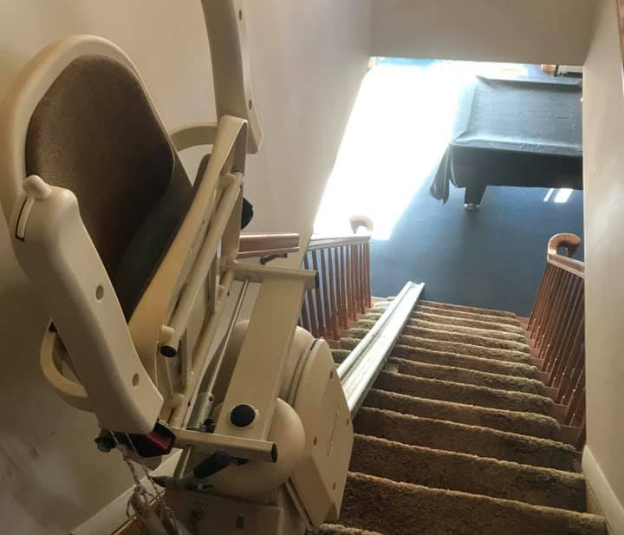
Online Equipment Exchange
MDTAP maintains the Maryland Assistive Technology Exchange, an equipment exchange page through Facebook Yardsale

Slide 16
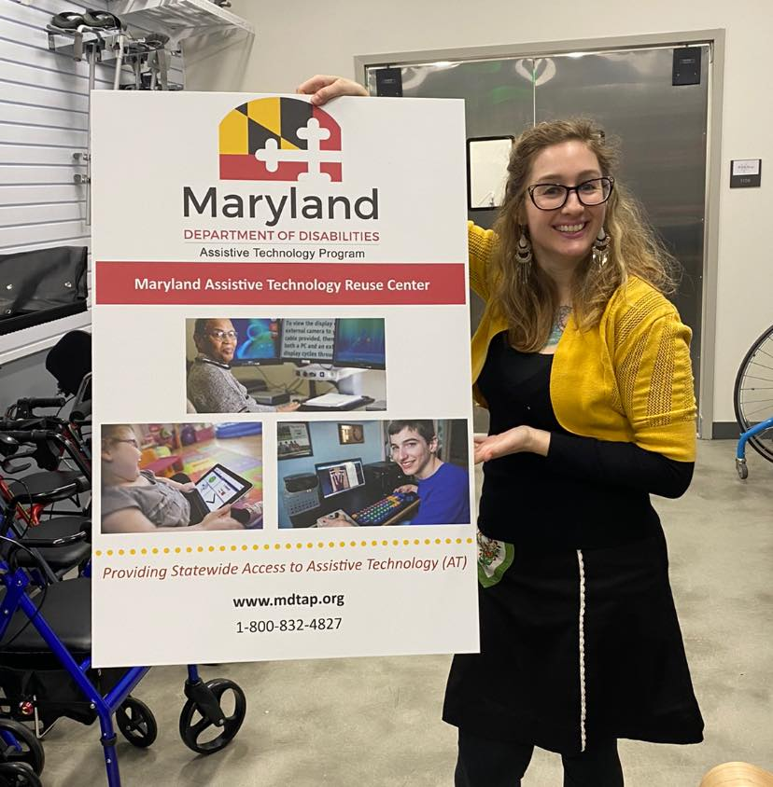
Maryland High-Tech AT
Reuse Center (MATR)
MD AT REUSE (MATR) EQUIPMENT
  CCTVs/Video Magnifiers/Magnifiers
  iDevices
  Adapted computer keyboards, mice, switches
  Speech communication devices
  Amplified telephones
  And more
  Search all available items online
Visit MATR By Appointment Only –
7125 Riverwood Drive, Suite D1 Columbia, MD 21046
To schedule a MATR donation, consultation, or pickup, contact 443-326-9703 MDTAP.AT-Reuse@maryland.gov

Slide 17


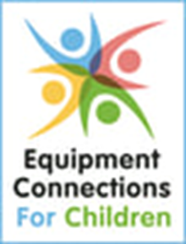
Other Statewide Equipment Reuse Options
The Maryland Department of Aging Equipment Reuse Program provides durable medical equipment (DME) to Marylanders with any illness, injury, or disability, regardless of age, at no cost.
Pediatric DME, too
From adapted strollers to gait trainers, therapy equipment to car seats, these programs are ensuring that all families and all children have exactly what they need to thrive.
  Lollipop Kids Foundation
  Equipment Connections for Children

Slide 18

FUNDING AT

Slide 19
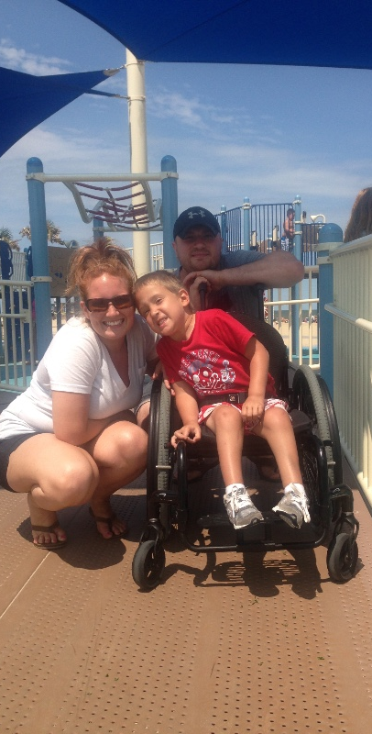
AT Financial Loan Program Snapshot
Provides low-interest loans to Maryland residents with disabilities or their families to buy assistive technology
Loans issued to those who cannot otherwise afford a loan but still maintain a good likelihood of repaying the loan
Covers all types of AT including vehicles, computers, hearing aids, home modifications, and more
$500 -$10,000 for general AT purchases
Up to $20,000 for Home Modifications

Slide 20
iDrive Maryland
Expanding access to affordable vehicle loans for Marylanders with disabilities, particularly those in rural areas of Maryland, who are more likely to face limited access to transportation, higher poverty rates, and greater unemployment.

Slide 21
iDrive Maryland
Loans for both adapted AND non-adapted vehicles
Interest rates currently offered at 3%
Loan amounts up to *$70,000 for vehicles
Up to 120-months (10 year) repayment terms for some vehicles*
*some restrictions apply

Slide 22

How to Apply
You can easily and securely Apply online here!
Or download the application
and submit by email to mdtap.atlp@maryland.gov

Slide 23
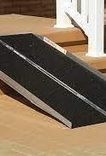
Statewide
Portable Ramp Access Project
MDTAP oversees the statewide portable ramp project, loaning a variety of portable ramps to consumers who need short-term ramp solutions. These ramps are housed at 6 local Centers for Independent Living across the state:
IMAGE Center of Maryland – Baltimore City, Baltimore County, Harford County
Independence Now – Montgomery County, Prince George’s County
Accessible Resources for Independence – Howard County, Anne Arundel County
Southern Maryland CIL - Calvert County, Charles County, St. Mary’s County
Resources for Independence - Allegany County, Garrett County, Washington County
Bay Area CIL – Caroline, Cecil, Dorchester, Kent, Queen Anne’s, Somerset, Wicomico, Worcester

Slide 24
Other AT Funding Sources
CILs AT Grants – These can often go up to $5,000, but many require a % contribution from the consumer. Each of the 7 CILs maintain their own structure and application process.
LISS Funding – up to $2,000 for services and devices.
Medicaid Waiver Programs – all 3 (Family Supports, Community Supports, and Community Pathways) include AT and AT Services, though the amounts fluctuate.
Local service organizations such as Business and Professional Women's Associations, Exchange Club, Kiwanis, Elks, Lions, SERTOMA, JayCees, Church Groups, "A Dream Come True", "Make-A-Wish", Masons/Shriners, Churches, Knights of Columbus, and the Quota Club.

Slide 25
Partner Programs

Slide 26
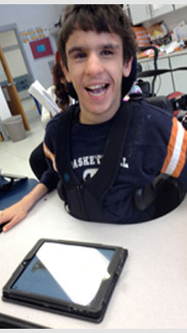
Discounted Assistive Technology – Purchasing Cooperative
MDTAP partners with AT Discount Sales & Services, LLC to access the lowest prices for AT when purchasing equipment. And you can too!
    AT Discount Sales & Services, LLC provides discounts and product information for all AT needs.
    410-290-1327
    amanda@atdiscount.net
    www.atdiscount.net

Slide 27


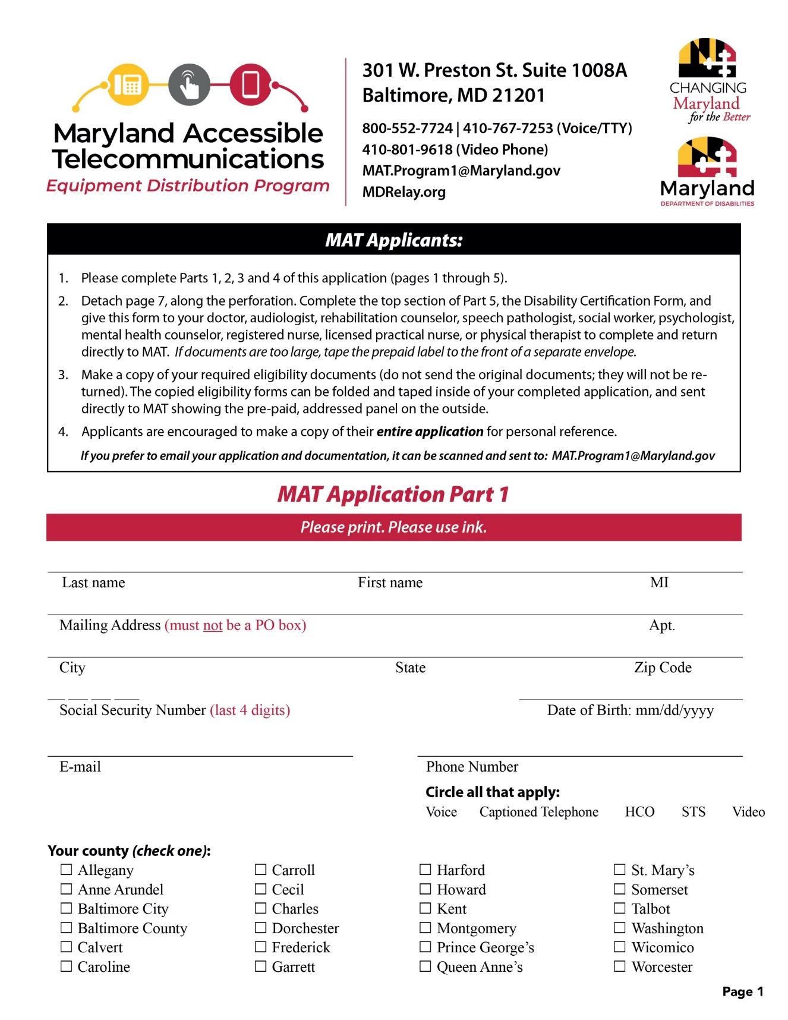
MAT Program
  Landline and mobile phones are available for people with hearing loss, vision loss, physical disabilities, and I/DD.
  For anyone 3 and up, who qualifies.
  Application available online
  Call 800-552-7724 or 410-767-6960 (Voice/TTY) or 443-453-5970 (Video Phone) to request by mail
  Email MAT.Program1@Maryland.gov and request an electronic application
Notes:
The Maryland Accessible Telecommunication Program provides telecommunication devices to qualifying MD citizens. Considered a loan at no cost, anyone 3 and older, that is a Maryland resident who receives a federal benefit and has a verifiable disability will qualify.
For the application or for more info, contact MAT at ……

Slide 28
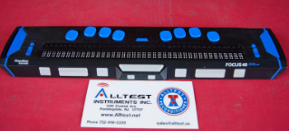
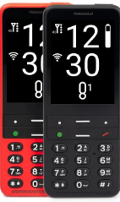
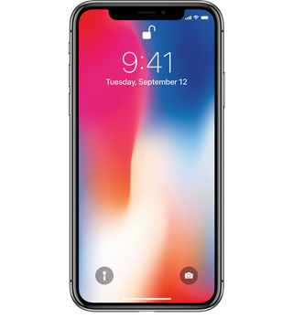
What Telecommunications Equipment is Available?
Blindshell Classic 2
Iphone 14
Ipad
Braille displays, BT keyboards and other necessary accessories equipment
Specialized Services for DeafBlind
Notes:
The program is always considering new equipment and currently offers iphone 14, ipads, Androids and Blindshell Classic2. MAT also provides accessory equipment such as Braille displays, switches, mounts and Bluetooth keyboards.
For Maryland citizens who are DeafBlind, the MAT program has implemented a Communication Facilitator program that includes equipment accessible to Deafblind and 1-1 facilitator services for protactile/tactile speakers. Contact MAT for more information.

Slide 29




MD AT Info Everywhere
Where It’s AT – Our award-winning AT Blog
Find us on Facebook -
Follow us on Twitter -
Watch us on YouTube –

Slide 30
CONTACT US
Central Office
  Maryland Technology Assistance Program
  2301 Argonne Drive, T-42
  Baltimore, MD 21218
  (800) 832-4827 (voice)
  (866) 881-7488 (TTY)
  (410) 554-9237 (fax)
  MDTAP.General@maryland.gov (e-mail)
  www.mdtap.org (web)

