Slide 1
What is clinical research? What does it mean for me?
Marin P. Allen, Ph.D.
Accessible Pharmacy SEMINAR 10/13/23

Slide 2
Good morning or afternoon and many thanks!

Slide 3
Today’s Agenda
→Overview of why clinical research is done
→Scope of clinical research: observational studies, clinical trials, and the phases of clinical trials
→How to Find Studies that are recruiting
→Questions you might want to ask about participating in a particular study
→Rights and Responsibilities of volunteers
→Informed consent
→Caveat
→Interpreting what you hear about study results, a brief quiz
→Resources to keep for your reference

Slide 4
Clinical Research
The study of health and disease in people, all people

Slide 5
Why do scientists do different kinds of clinical studies?
→ To explore the cause of a disease or a set of symptoms
→ To test if a treatment will help with a symptom or condition
→ To learn how a certain behavior affects the health of people

Slide 6
(continued)
→ Clinical research is focused on what we know or don’t know about diseases, disorders, or behaviors in people.
→There are often different studies that approach the same question in different ways.
→Clinical research is hard and complicated, but very necessary and requires a wide range of skills, scientists, medical professionals, and , most importantly, volunteers.

Slide 7
I can hear some of you thinking, “But, we asked about clinical trials?

Slide 8
Clinical Research: Observational Studies
► Case Study / Case Series
► Ecological Study
► Cross-Sectional Study
► Case-Control Study
► Cohort Study

Slide 9
Observational Studies
Case Study / Case Series
Careful, detailed description of one or more patients. By documenting new or unusual cases, a scientist can start to develop hypotheses (ideas that can be formally tested). These scientists are often looking for causes or risk factors.
Ecological Study
Compares the rate of disease or condition for groups of people, such as towns in different climates, or places with different incomes, or differing populations.

Slide 10
Observational Studies
Cross-Sectional Study
A “snapshot” of many people at one point in time. These studies can show how common a condition is and help identify factors associated with it.
Case-Control Study
A group of people who have a condition is compared to a control group of people who don’t. Possible causes or risk factors can emerge.
Cohort Study
A large group of people is observed over time. Some eventually develop a disease or condition. Researchers can learn how often the condition occurs and find possible causes or risk factors.
Here’s a classic example of a cohort study! Framingham
Notes:
An important note here is that clinical research needs everyone who would like to participate, not just those people who have a disease, disorder or are differently abled.

Slide 11
Grandfather/Grandmother of Cohort Studies: A Word about Framingham
The Framingham Study-Cardiovascular Health
GEN1: In 1948 the study began in Framingham, Massachusetts with 5,209 men and women between the ages of 30 and 62. This was 2/3 of the population. Volunteers were given extensive physical exams and lifestyle interviews. These volunteers would return every two to six years for additional lab tests, physical exams, and detailed medical histories.
GEN2: In 1971, 5,124 of the adult children and their spouses, were enrolled.
GEN3: April, 2002 the grandchildren of the original cohort were enrolled!

Slide 12
Representative findings from more than 3,000 papers
► Key findings across the decades that you are probably familiar with are the effect of cigarette smoking on heart disease, major findings in causes of stroke, including prehypertension and sleep apnea
► Additionally, the research has shifted, through discovery, with the newest findings related to genetics, additional populations, and new tools.

Slide 13
And then, the “Omni Cohort”
Researchers recognized the need to establish a new study reflecting Framingham’s more diverse communities. In 1994 they enrolled the first Omni Cohort of the Framingham Heart Study—507 men and women of African-American, Hispanic, Asian, Indian, Pacific Islander, and Native American descent. In 2003, a second group of Omni participants was enrolled.

Slide 14
Another Framingham Heart Study Continuing Benefit: Data Sharing
An outstanding feature of the FHS is that it has, from its early days, been data sharing. From the National Heart Lung and Blood Institute at NIH: “In 1968, the FHS made massive data tables of FHS-collected measures freely available to outside researchers, many of whom lacked computer resources. NHLBI has continued to leverage FHS resources to spur new scientific discovery through data sharing.”
For scientists, researchers, voluntaries on the call, link to that resource is in the resources section.
https://biolincc.nhlbi.nih.gov/teaching/ and information on specific studies
For the research dataset, one must apply and respond to ethical and other documentation for appropriate use.

Slide 15
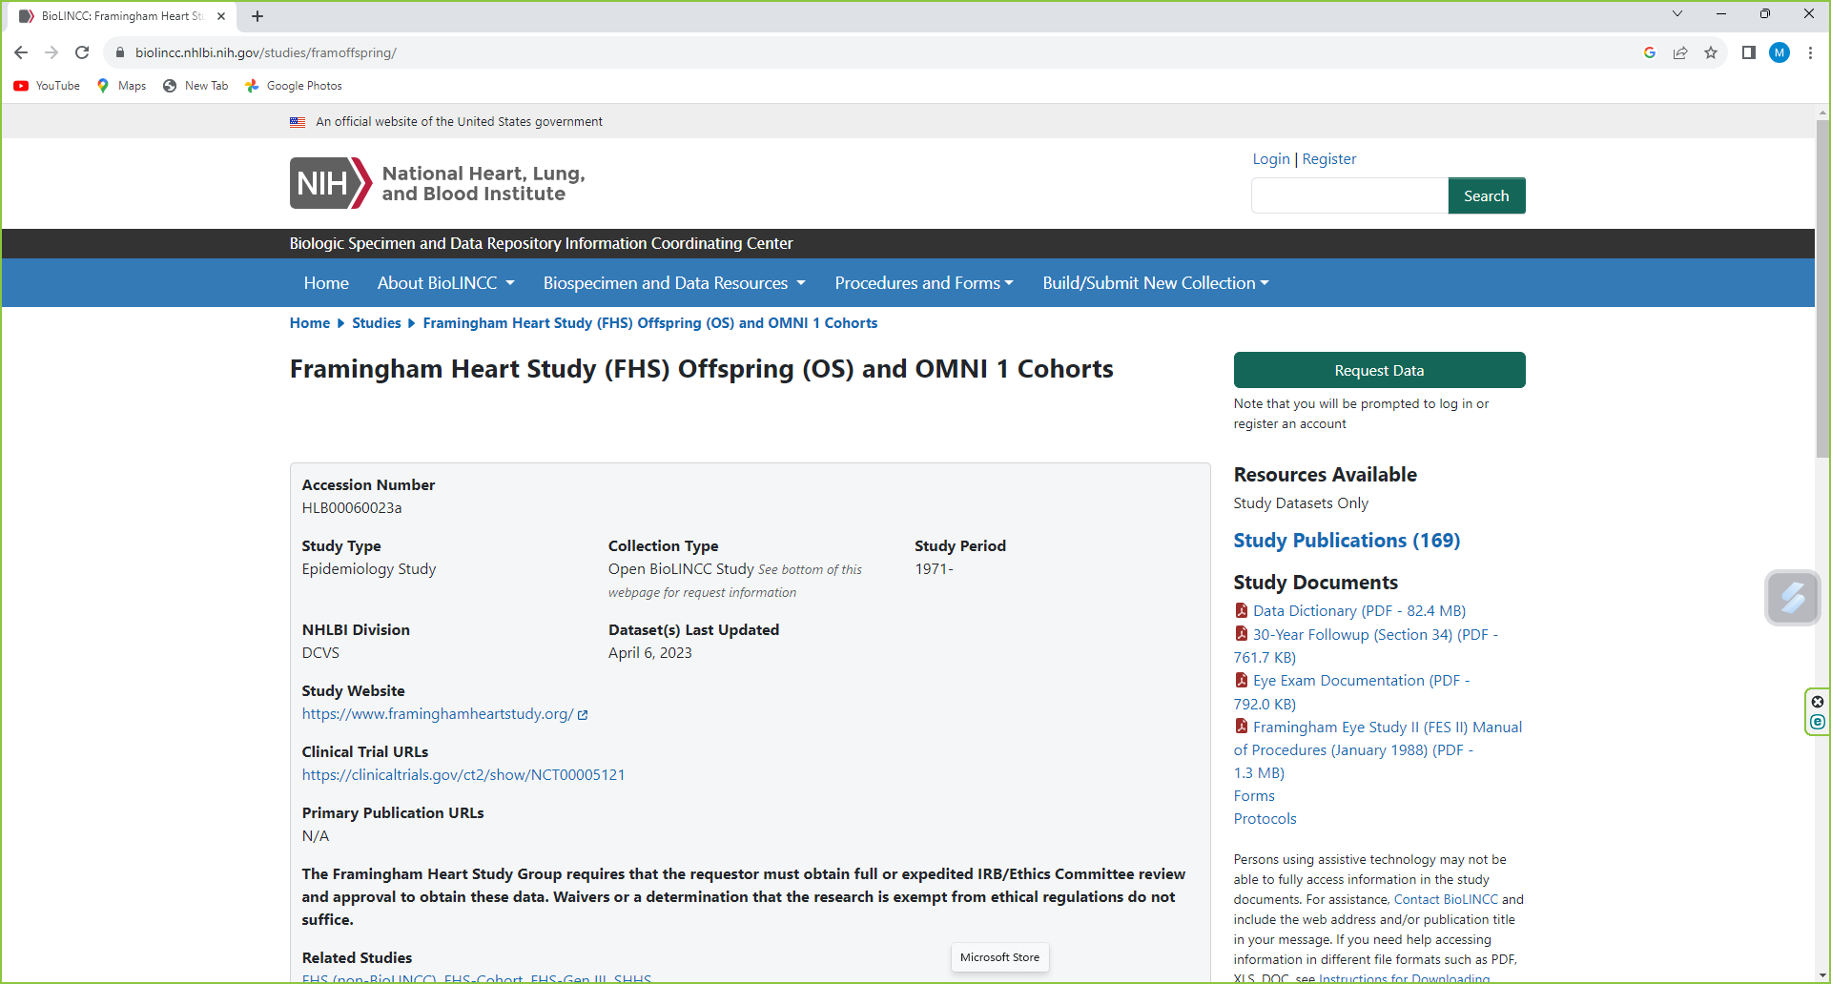

Slide 16
Clinical Trials and You . . .
Now, we can get more specific

Slide 17
Clinical Trials
In these studies, researchers test new ways to prevent, detect, or treat disease. Treatments might be new drugs or combinations of drugs, new surgical procedures or devices, or new ways to use existing treatments.
Sometimes you hear, “A well-designed clinical trial is the gold standard for proving that a treatment or medical approach works,” but clinical trials can’t always be used. For example,
scientists can’t randomly assign people to live in different places, or ask people to start smoking or eating an unhealthy diet.
Safety of the participants is always paramount.

Slide 18
NIH Definition of a Clinical Trial
“A research study in which one or more human subjects are prospectively [in order to discover what is likely to happen in the future] assigned to one or more interventions (which may include placebo or other control) to evaluate the effects of those interventions on health-related biomedical or behavioral outcomes.”

Slide 19
The Food and Drug Administration: Critical, Regulatory Partner
“Protecting the rights, safety and welfare of people who participate in clinical trials is a critical aspect of the FDA’s mission. FDA oversees clinical trials to ensure they are designed, conducted, analyzed and reported according to federal law and good clinical practice (GCP) regulations. FDA’s regulations and guidance for clinical trials help support efficient medical product development, while assuring trials generate the robust evidence needed to assess product safety and efficacy. The agency works to ensure its GCP policies continue to facilitate new approaches to generating quality clinical evidence.”

Slide 20
FDA: The Investigational New Drug (IND) Process
Regulatory Authority:
A sponsor or developer of a new drug, must submit an Investigational New Drug (IND) application to the FDA before beginning clinical research.
-FDA offers help to any point in drug development in drug development
-FDA IND review team includes a project manager, medical officer, statistician, pharmacologist, pharmakineticist, chemist, and microbiologist-
-Review team has 30 days to review the original IND submission.
Purpose: To protect volunteers who participate in clinical trials from unreasonable and significant risk in clinical trials.

Slide 21
FDA responses to INDs and further protections
Two possible responses from the IND:
1. Approval to begin clinical trials.
2. Clinical hold to delay or stop the investigation. This action is rare.
FDA often provides comments intended to improve the quality of a clinical trial.
Developer is responsible for informing the review team about new protocols as well as serious side effects seen during the trial. After the trial ends, researchers must submit study reports.
This process continues until the developer decides to end clinical trials or files a marketing application. Before filing a marketing application, a developer must have adequate data from two large, controlled clinical trials.

Slide 22
Clinical Research: Clinical Trials-Scope

Slide 23
Clinical trials are conducted in specific phases:

Slide 24
Phase I • Purpose: Find out whether a medical approach (e.g., drug, diagnostic test, device) is safe, identify side effects, and figure out appropriate doses. • Number of people: Typically fewer than 100
Phase II • Purpose: Start testing whether a medical approach works. Continue monitoring for side effects; get information that goes into designing a large, phase III trial. • Number of people: Typically 100-300

Slide 25
Phase III • Purpose: Prove whether a medical approach works; continue monitoring side effects. • Number of people: As many as needed or able to enroll—can be 1,000 or more
Phase IV • Purpose: When a medical approach is being marketed, continue gathering information on its effects. • Number of people: Thousands

Slide 26
How do these kinds of studies compare in showing cause and effect?

Slide 27
More about you . . .

Slide 28
Learn what you can expect in the study
Before you decide to join, you’ll want to know exactly will happen in the study, and also what the study team expects from you.
What will my responsibilities be if I participate?
What kinds of tests, treatments, and procedures will happen during the study?
Who will be in charge of my care? Will I be able to see my own doctor?
Will I be able to continue with other treatments if I participate?

Slide 29
NEI: Clinical Trials: Questions to Ask
►Before you join a clinical trial or study, it’s important to figure out whether it’s the right choice for you. Each study is unique, with different risks and benefits.
► When you talk to the study staff, make sure to find out as much as you can. Ask plenty of questions — remember, it’s the study staff’s job to answer them. Read these questions to get ideas for what to ask.

Slide 30
Questions to Ask (continued)
Learn about the study
Understanding why researchers are doing the study can help you decide if it’s right for you.
What is the purpose of this study?
Why do researchers think this treatment might work?
How is this treatment different from other treatments that are available?

Slide 31
Find out about the benefits of being in the study
There are lots of great reasons to participate in a clinical trial, but the specific benefits will depend on the study.
How might the treatment help my condition?
How else will I benefit from joining this trial?
How will the results of this trial benefit other people like me?
Will I be paid for participating?

Slide 32
Benefits
— For society in general, new knowledge adds to collective progress
— Individually, you could benefit if you are one of the first to try a new treatment that is successful. Or, if you have an eye disease that runs in your family, new information or treatments could help others in your family.

Slide 33
Ask about the risks of being in the study
Important note: It’s the researcher’s job to keep study participants as safe as possible, but all clinical trials have some risks — and it’s important to make sure you understand what they are.
What do researchers know about side effects of the treatment?
What are the chances that I will have side effects from the treatment?
What are the possible short- and long-term effects of the treatment?
How do the possible risks and side effects compare to my current treatment?

Slide 34
Risks and Benefits (continued)
Risks
►Because new, risks are not fully knows. It is possible that the treatment, for example, could harm you or have side effects.
► However, a team of doctors, nurses, and support staff will give you checkups to find any side effects and make sure you are healthy enough to stay in the trial.
An independent group of experts will also monitor the trial. If the experts find that the risks of the new treatments outweigh the benefits, they stop the trial right away.

Slide 35
What rights do volunteers have?
People who volunteer to participate in clinical trials have the right to:
Ask questions about the trial
Leave the trial at any time
Keep their medical information private and stay anonymous in reports about the trial

Slide 36
Rights (continued)
Volunteers also have the right to know things about the trial, including:
Risks, benefits, and costs of the trial
What they will need to do during the trial
Where the trial will happen and how long it will last
How researchers will use volunteers’ private medical information
Any new information about the treatment that researchers find during the trial
After the trial is over, volunteers also have the right to know whether they were in the treatment group or the control group.

Slide 37
From NEI at NIH: What does it cost to join a clinical trial?
Volunteers who join clinical trials at the NEI Eye Clinic in Bethesda, Maryland pay nothing for their participation, and they may qualify for support with travel expenses and other related costs. Other sponsors may include:
Other U.S. Federal agencies
The company that makes the treatment or test
Individuals
Universities
Organizations
Sponsors cover the costs of the clinical trial. But before you join a trial, ask the trial staff about costs for you. Then check with your health insurance company to see if your plan will cover any costs that the sponsor doesn’t cover.

Slide 38
and, there’s more . . .
Eligibility Criteria
Why?
Informed Consent
A document signed after the trial is fully explained and all of your questions are answered, including as to the risks, requirements, and rules of the trial.

Slide 39
Caveat
Human induced pluripotent stem cell colony
by National Institutes of Health (NIH)

Slide 40
(Concern) I promised earlier
A warning about stem cell clinics from the National Eye Institute
“Every day, researchers are learning new things about how stem cell treatments can help with eye health and vision loss. But some stem cell clinics are already advertising these treatments as ‘miracle cures’-without knowing if they work or if they are safe. And they may charge thousands of dollars for these unproven treatments, which aren’t covered by insurance.
If you are interested in getting stem cell treatment, talk to your doctor about it. He or she can help you understand if the treatment could be right for you. And they can find out if the treatment is FDA -approved or if there is a clinical trial you can join.”

Slide 41
A word about Implementation Science
“The 17 Year Issue”
“It takes an Average of 17 Years for Evidence to Change Practice-the Burgeoning Field of Implementation Science Seeks to Speed Things Up.” * Rita Rubin
“Colorectal cancer screening with an at-home stool test is more convenient than with a colonoscopy, but an abnormal result on the former still requires a follow-up with the later.”
Only about half of those with the abnormal at-home test get a follow-up colonoscopy within a year. (Rachel Issaka, MD. MAS, University of Washington gastroenterologist in this interview), “ . . . implementation science is really trying to close the gap between what we know and what we do.”
*JAMA. Published online April 5, 2023. doi:10.1001/jama.2023.4387

Slide 42
How do I find out about specific clinical trails?

Slide 43
ClinicalTrials.gov a “Need-to-Know-About” Resource

Slide 44
ClinicalTrials.gov is a website and a database
Content: Provides information about clinical studies
Users: the public (including potential research volunteers), researchers, and health care professionals
Submissions: Sponsors or researchers provide information about their studies
Scope: studies from the entire United States and from more than 200 nations around the world
Frequency of new study listing: almost every day
Database includes results and contact information on studies.
The study record is all the information submitted about a study. Information about each study is permanently available.

Slide 45
What’s in a study record?
-study name and description
-person or organization responsible for the study (sponsor or investigator)
-people or organizations that fund or provide support for the study
-disease or health problem studied
-start and end dates
-locations

Slide 46
What specific information about the study?
-Who can or cannot join the study (eligibility criteria)
-How many participants are needed
-A description of the intervention (s) that may be given (such as a drug, medical device, or behavior
-What researchers want to learn and how they will measure it
-How to contact the study staff
Some, but not all records contain the groups of participants e.g. average age, etc. (no personally-identifiable information) findings from the study; summary of any health problems called adverse events and the study protocol, analysis plan, and the informed consent form.

Slide 48
Listening to the news about “breaking” research . . .
As you evaluate the progress you are hearing about, listen for one of two words, “association” or “causation.” Just because two factors occur together, does not mean that one has caused the other. An association between factors like exercise and reduced heart disease in a specific study may provide an excellent signpost for further research.

Slide 49
Make sure it really is science: A Brief history of the 10, 000-steps-a-day measure.
“The concept of taking 10,000 steps a day to maintain health is rooted not in science but in a marketing gimmick. In the 1960s a company in Japan invented an early pedometer. Because the Japanese character for “10,000” looks like a person walking, the company called its device the 10,000-step meter. (May 1, 2023)”
https://www.scientificamerican.com/article/you-dont-really-need-10-000-daily-steps-to-stay-healthy/
Notes:
The slide includes the information I just read, a link to a Scientific American article and the Japanese character for the number 10,000

Slide 50
Selected Resources for More Information

Slide 51
Food and Drug Administration: Clinical Research Resources
https://www.fda.gov/science-research/science-and-research-special-topics/clinical-trials-and-human-subject-protection

Slide 52
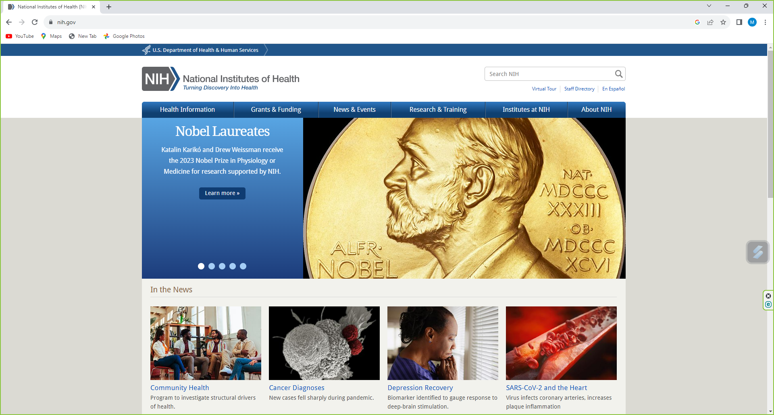
www.nih.gov
www.nih.gov

Slide 53
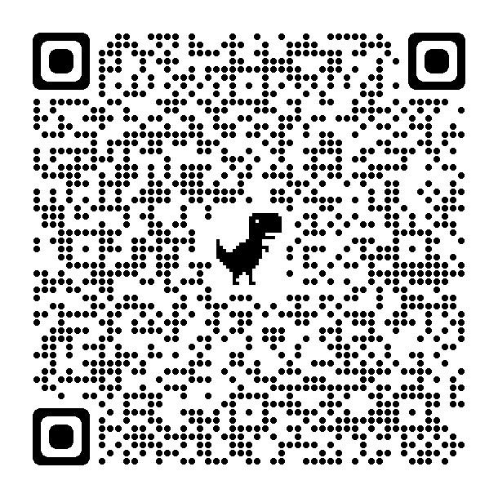
NEI: Clinical Trials in Vision Research
Nook and iPad (EPUB, 1.6BM) | Kindle (MOBI, 1.7MB)
PDF (1.5 MB)

Slide 54
National Heart, Lung and Blood Institute FHS data sharing https://biolincc.nhlbi.nih.gov/studies/framcohort/

Slide 55
https://nihrecord.nih.gov/2023/10/13/rosenberg-s-research-spans-half-century-and-counting
A story That demonstrates how it all works

Slide 56
A quick quiz: Loneliness and Risk of Parkinson Disease October 2, 2023
Question Is loneliness associated with an increased risk of developing Parkinson disease?
Findings In this cohort study of 491,603 participants followed up for up to 15 years, loneliness was significantly associated with an increased risk of incident Parkinson disease independent of demographic and socioeconomic factors, social isolation, genetic risk, and physical and mental health.
Meaning The findings suggest that loneliness is associated with increased risk of developing Parkinson disease.
Design, Setting, and Participants This prospective cohort study included a population-based sample of UK Biobank participants aged 38 to 73 years with loneliness data and without a diagnosis of PD at baseline who were first assessed from March 13, 2006, to October 1, 2010, and followed up to October 9, 2021.
Antonio Terracciano, PhD¹; Martina Luchetti, PhD²; Selin Karakose, PhD¹; et alYannick Stephan, PhD³; Angelina R. Sutin, PhD² Author Affiliations Article Information JAMA Neurol. Published online October 2, 2023. doi:10.1001/jamaneurol.2023.3382

Slide 57
Thank you!
* Note: Opinions expressed in this presentation are those of the author.

