Slide 1
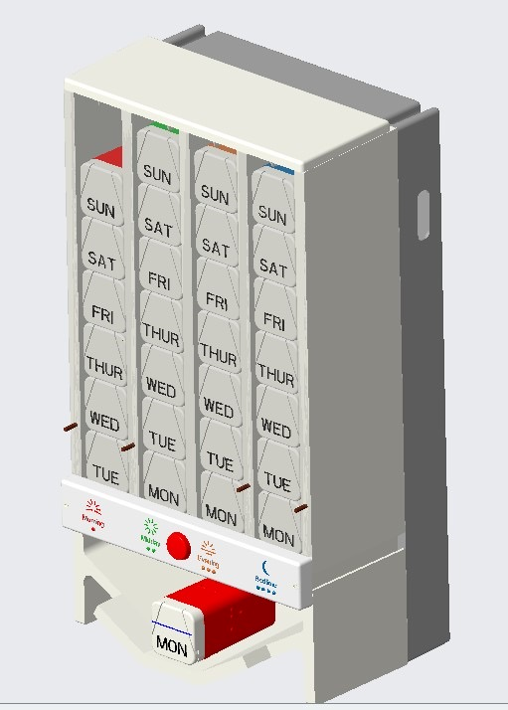
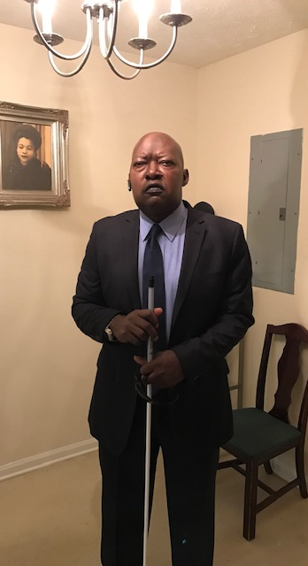
Time-Touch-Take
Dr. Barbara Coatney
Notes:
Imagine you have a mother, grandmother or friend who is disable, elderly, blind and is unable to stay in their home due to medication errors. I had this, my brother-in-law Ronnie. He was in the hospital each month because of medication errors. He had not one, and I had to come up with a way for him to take his medication without errors. This is my reason for Time-Touch-Take.

Slide 2
Research tells us that!
54.1 Million 65 + www.uscensus.gov
2 out of 3 use prescription drugs
Take 4-5 prescription drugs a day
Fill 12/17 prescriptions a year

Slide 3
Problem?
Limited Dexterity
Hard to distinguish Pills
Pills are small
Doctors have limited time.

Slide 4
How useful is this device?
Smart
Device
Time*Touch*Take
Helpful
innovative
Easy to Use
Notes:
Development of a system that is a:

Slide 5
Time*Touch*Take Medication Dispenser
Bottles
Caregiver
Color-Coded
Large Bottles.
In-home every 7 days
Load Medication
Medication
Dispenser
Technology
Purchase
App: Message system, 3 contacts, emergency information
Sale or Rental

Slide 6
Video Demonstration

Slide 7
Thank You
Time
Time-Touch-Take take pre-orders beginning in December. Visit our website at www.timetouchtake.com
Contact
I can be reached at timetouchtake@gmail.com
Quote
Quote: My mom is almost blind. She can no longer get the pills out of her pill box without dropping some. She can remember to take them but gets AM/PM mixed up.

