Slide 1
CONFIDENTAL & PROPRIETARY
Any use of this material without specific permission of PRISM Vision Holdings LLC is strictly prohibited
Blindness and Clinical Trials Webinar
October 13th, 2023
Clinical Research Dpt
Maggie Cashion, Clinical Research Mgr

Slide 2
Why Clinical Research at Prism Vision Group?
For the Patients
To provide new treatment options to our patients
Care and study drug/device is provided free of charge to study subjects
For the Physicians
New medical findings that build physician knowledge, satisfy physician professional interests, and foster physician morale
Prestige and publicity that may attract new patients and foster physician esprit de corps
Additional revenue to the practice and additional compensation to physicians involved in the trial

Slide 3
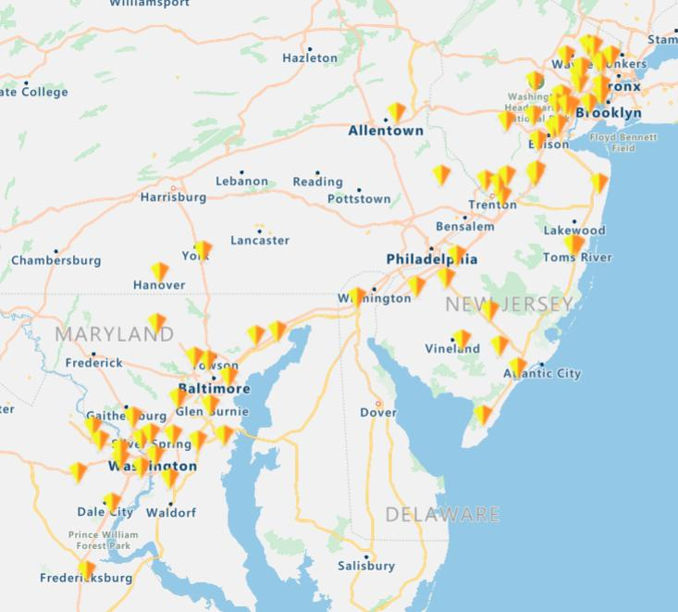
Geographical Scope of Prism Vision Group
8 Research Locations – Retina and Ophthalmology
NJR
Teaneck
Toms River
Edison
RCC
Baltimore
RGW
Chevy Chase, MD
Fairfax, VA
EAV
Vineland, NJ
SPEA
Harve De Grace, MD

Slide 4
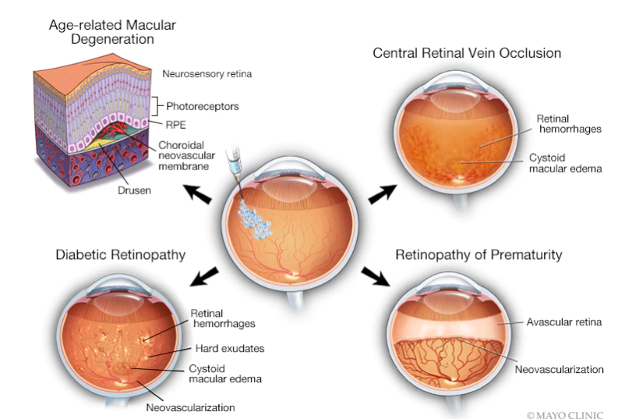
Anti-VEGF Drugs in the Treatment of Retinal Diseases
Main Studies – injections of IP, device studies.
Few Ophthalmology Studies – Glaucoma, Dry Eye, IOL

Slide 5
2023 Research Org Chart
MAGGIE CASHION
Research Manager
CBO
HEATHER KROL Research Finance Coordinator
AMY LEVITON Data Management Coordinator
NJR Teaneck
NJR South
Tom’s River
&
Edison
RCC
Baltimore
RGW
Fairfax
EAV
SPEA
JOSEPH PORTELLI
Sr. CRC
Chevy Chase
AMANDA McGEE Sr. CRC
HEENA AHLUWALIA
Sr. CRC
NIKEL GIBBONS
CRC
JUANITA FLORES Lead CRC
CAROL SEIDENBERG
Sr. CRC
KEROWYN SMITH
CRC
DINA CHRISTODORO Sr. CRC (Mat. Leave)
Aline Diaz, CRC
GABRIELLE O’DANIELL
Sr. CRC
FLORA BERREFAS
CRC
TIA ARIAS
CRC
LAURYN ONKENDI
CRC
PHILLIP PRICE
CRC
NELLY VELASCO
CRC
ANDY MERINO
CRC
CONNOR ERVIN
CRC
RACHEL RIVERA
CRC
DANIELLE DOWNER
CRC
Open CRC position, interviewing
CHARLES CROUSE
CRA

Slide 6
Overview of Drug Pipeline in the US
The FDA is responsible for review and approval of new drugs.
It takes 12-15 years for an experimental drug to travel from the lab to US patients.
New interventions aren’t offered to the public as soon as they’re developed.
Clinical trials determine safety & efficacy of a drug/device/test. If safety and efficacy results satisfies FDA, then that drug/device/test may become tomorrow’s standard of care.
5 phases:
Discovery/concept
Preclinical research
Clinical research
FDA review
FDA post-marketing safety monitoring
Pre-Clinical Studies
(~500 compounds)
3-6 years
Clinical Trials
(~10 compounds)
6-7 years
FDA approval
1 compound
2 years
10,000 to 20, 000 compounds
Notes:
Phase 1: Determine safety and dosage. Phase 2: Evaluate effectiveness, look for side effects, phase 3: Confirm effectiveness, monitor adverse reactions from long-term use
, phase 4: Additional post-marketing testing required by FDA

Slide 7
Good Clinical Practice and International Conference on Harmonization
Foundations of Ethical Research
Nuremberg Code in 1947
10 basic principles, including:
Voluntary consent is essential
Benefits outweigh the risks
Useful results
2. Declaration of Helsinki in 1964
Beginning of the IRB.
3. Belmont Report in 1979
4. ICH: International Conference on Harmonization
Developed the guidelines for GCP on April 30, 1996.
Key objectives and principles of GCP:
It is an international ethical and scientific quality standard for designing, conducting, recording and reporting trials that involve human subjects.
Compliance provides the public assurance that the rights, safety and well-being of trial subjects are protected and that the clinical trial data are credible.
Subject safety
Documentation and Record Keeping
Research misconduct

Slide 8
Informed Consent Process
Why do we obtain informed consent?
8 Mandatory Elements of
Informed Consent
Research
Risks
Benefits
Alternatives
Confidentiality
Research-Related Injury
Contact
Voluntary
Reference:
21 CFR Part 50 (Protection of Human Subjects)
It is the law!
Protects the rights, safety and well-being of subjects
Ensures the subject is fully and accurately informed and decision is voluntary
Who obtains Informed Consent?
Qualified research team members (Principal Investigator
Study personnel designated and trained by the PI - Sub-investigator, CRC, key personnel) obtain subject’s consent.
It’s a process
Ongoing interaction between the potential subject and research personnel - opportunity for education and assessment of participant’s voluntariness to participate
Begins with the first contact and exchange of information
Continues beyond study termination - Signing of the ICF is the initial phase of the process

Slide 9
Partnering with PVG – advantages to Pharma
Ease of negotiations, Robust Staff, Oversight/QC
Signed confidentiality agreement: 1-5 business days
Sponsor/CRO feasibility assessment: 1 week- 1 month
We receive contract, budget and start up package and work on all concurrently.
Contract/Budget Negotiations Average: 28 days
Can negotiate same contract/budget for multiple sites
Medical Advisory sub-committee reviews new proposals
Clinical Trials Manager and Regulatory Coordinator: negotiate budgets, review contract (with legal)
Clinical Research Coordinator submits to the IRB, provides necessary documents
Relationship with pharmaceutical and device sponsors and Contract Research Organizations
Oversight of research operations, including all Clinical Research Coordinators
Interface with Finance and Operations to ensure proper allocations of funds, invoicing, reconciliation

Slide 10
Study Monitoring
Monitors aka Auditors
Sponsor often choose of Contract Research Organization (CRO) to monitor the study for them.
CRO will send a Clinical Research Associate (CRA, aka monitor) to the site.
Contact your monitor if you have any questions about study conduct.
During a interim monitoring visit (IMV), the monitor will review:
The regulatory binder
Patient binders
They will issue queries for any findings. The CRC can resolve queries.
Ex of queries:
Discrepancies between source doc and EDC entries (typos?)
Missing information
Procedures done incorrectly or in wrong order
Protocol deviations

Slide 11
Marketing
Implementing chart of enrolling studies, newsletters, emails, flyers, 3rd party vendors
Check Google, social media, radio/tv ads, Clinical Trials.gov for Clinical Trial Opportunities in your area! Also, ask your provider (MD).

Slide 12
Life Cycle of a Clinical Trial at RGW, RCC, NJR, SP Eye
Discovery:
A physician is approached about a new study, and is provided a confidentiality agreement.
Confidentiality agreement provided to Maggie, reviewed by Legal, signed by COO
Study is reviewed by the medical advisory sub-committee.
There may be a feasibility visit by the sponsor of the study at the study site.
Start Up process:
If approved, we proceed to budget & contract negotiations and other start up activities.
The contract is signed after legal approval
Study Conduct:
A Site Initiation Visit (SIV) takes place at the site- all research staff members are trained.
Study is activated and patients are enrolled.
Study ends, sponsor performs a close out visit

Slide 13
Study Visits (vs. Clinic Visits)

Slide 14
Clinical Trials Organization
Study conduct
Once a patients agrees to participate in a study, the study coordinator will obtain the patient’s consent.
The patient’s first study visit is the screening visit. The goal of the screening visit is to determine whether the patient is eligible (aka fits the inclusion and exclusion criteria of the study). If a patient is not eligible, they have screen failed.
Study subjects are randomly assigned to a treatment group-this is the randomization process.
Only one eye is chosen as the “study eye”. The other eye is the “fellow eye”.
Patients are randomized to receive either study drug (investigational product or IP) or placebo/active comparator drug.
Wet AMD/DME: active comparator: Eylea or Lucentis
Dry AMD: placebo (mock injection)

Slide 15
Masked vs Unmasked Roles
aka Blinded vs Unblinded Roles
Masked Person
Can NOT see!
Does NOT know the treatment the patient is getting
Who is masked: The primary study coordinator, the examining doctor, the subject.
Unmasked Person
Can see!
Knows the treatment the patient is getting
Who is unmasked: the person dispensing the drug, the injecting doctor.

Slide 16
Flow of a Research Patient in a Retina Practice
 | Staff | Study Procedure | Masking level
1 | Masked CRC | Consent, AEs, con meds, vitals, Blood Draw, Scheduling (2-5hrs) | Masked to tx. Unmasked to study eye.
2 | Refractionist | Refraction/Visual Acuity – only in 4meter room (1-2hrs) | Masked to study tx. Masked to study eye.
4 | Photographer | Obtain images (30mins-1hr) | Masked to tx. Unmasked to study eye.
5 | Masked MD (+masked CRC) | Examination- in exam room (20 mins) | Masked to tx. Unmasked to study eye.
6 | Unmasked MD (+unmasked tech) | Injection- in exam room (30mins) | Unmasked to tx. Unmasked to study eye.
7 | Unmasked Technician | Dispense medication, source documentation, check IOP, assist the unmasked MD (1hr) | Unmasked to tx. Unmasked to study eye.
Notes:
***************Plus: office managers guiding Athena templates per Doctor’s schedules, Senior Leads staffing the research offices with technicians, Front Desk PSR’s checking in research patients and collecting insurance info, Check Out PSR’s, Prism Regulatory Coordinator, Prism Finance and Accounting Tracking payments

Slide 17
Research Visit Duration
3 different visit types
SCREENING VISIT
This is the most time-consuming visit.
Consenting process: DO NOT read the ICF to the patient. Explain using language the patient can understand.
Med history, con meds: ~30 min
Vital signs, questionnaires (VFQ, FRI): ~30 min
VA- BCVA, LL-BCVA, Mn Read: ~1 hour
Imaging: OCT, FA, ICG, FAF- usually all the imaging is done at the screening visit: ~1 hour
Examining physician
No injection!
MILESTONE VISIT
Milestone visits occur at key time points. For ex: baseline and 52 weeks→ it is often the primary outcome measure.
VA- BCVA, LL-BCVA, Mn Read: ~1 hour
Imaging: OCT, FA, ICG, FAF- usually all the imaging is done at the milestone visit: ~1 hour
F/U VISIT
F/U visits are the most common. These are the shortest visits.
VA-BCVA only: ~ 30-45 min
Imaging: OCT only

Slide 18
Benefits of the Trial
From a Study Pt Perspective
Car Service Transportation
Generous Per Visit Patient Stipend
Drug provided for non-study eye
Very close safety oversight
VIP Patient Experience

Slide 19
Open Discussion
Questions, Comments, Concerns
Thank you!

